Slide 1


WORK-CASE №1
Git: A Version Control System
Git is a powerful version control system used by developers to track changes in code and collaborate on projects.
Created: Krasavin Volodymyr

Slide 2

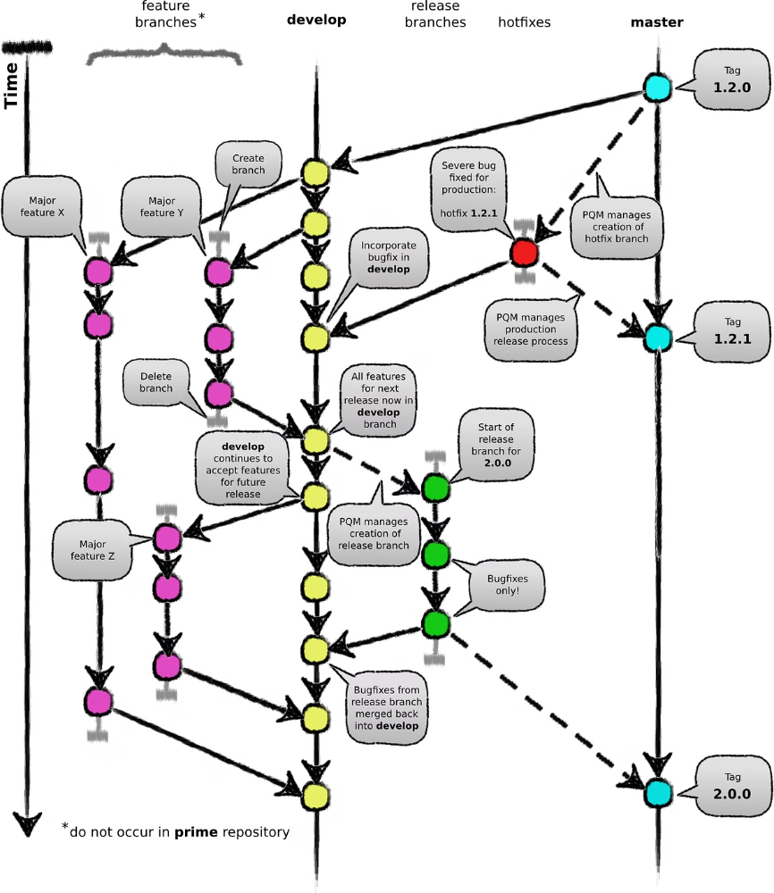
Git: Tracking Changes
1
Initialization
Git is initialized in a directory to start tracking changes.
2
Staging
Changes are staged before committing to the repository.
3
Committing
Staged changes are committed to the repository, creating a snapshot.

Slide 3
Git: Collaboration
Branching
Merging
Pull Requests
Branches allow developers to work on separate features without affecting the main codebase.
Changes from branches are merged back into the main codebase.
Pull requests allow developers to review and approve changes before merging.

Slide 4

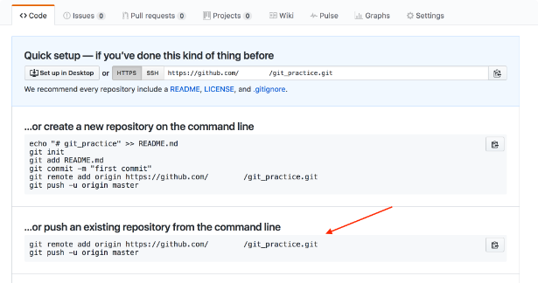
Git: Common Commands
1
git init
2
git add
Initializes a Git repository.
Stages changes for commit.
3
git commit
4
git push
Commits staged changes to the repository.
Pushes changes to a remote repository.

Slide 5


Git: Remote Repositories
GitHub
GitLab
Bitbucket
A popular platform for hosting Git repositories.
Another platform for hosting Git repositories.
A platform for hosting Git repositories, often used for private projects.

Slide 6

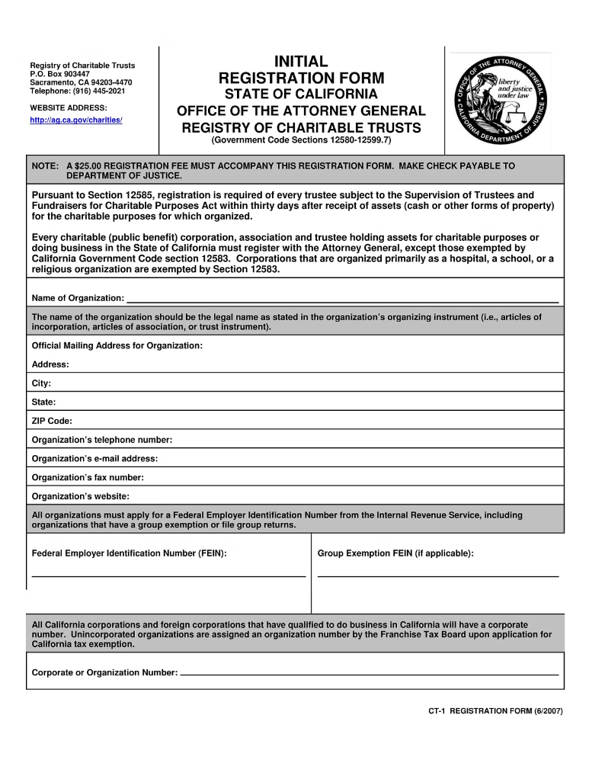



Creating a Git Account
Choose a Platform
Select a Git hosting platform like GitHub, GitLab, or Bitbucket.
Sign Up
Create an account by providing your email address and password.
Verify Account
Verify your email address to complete the registration process.

Slide 7

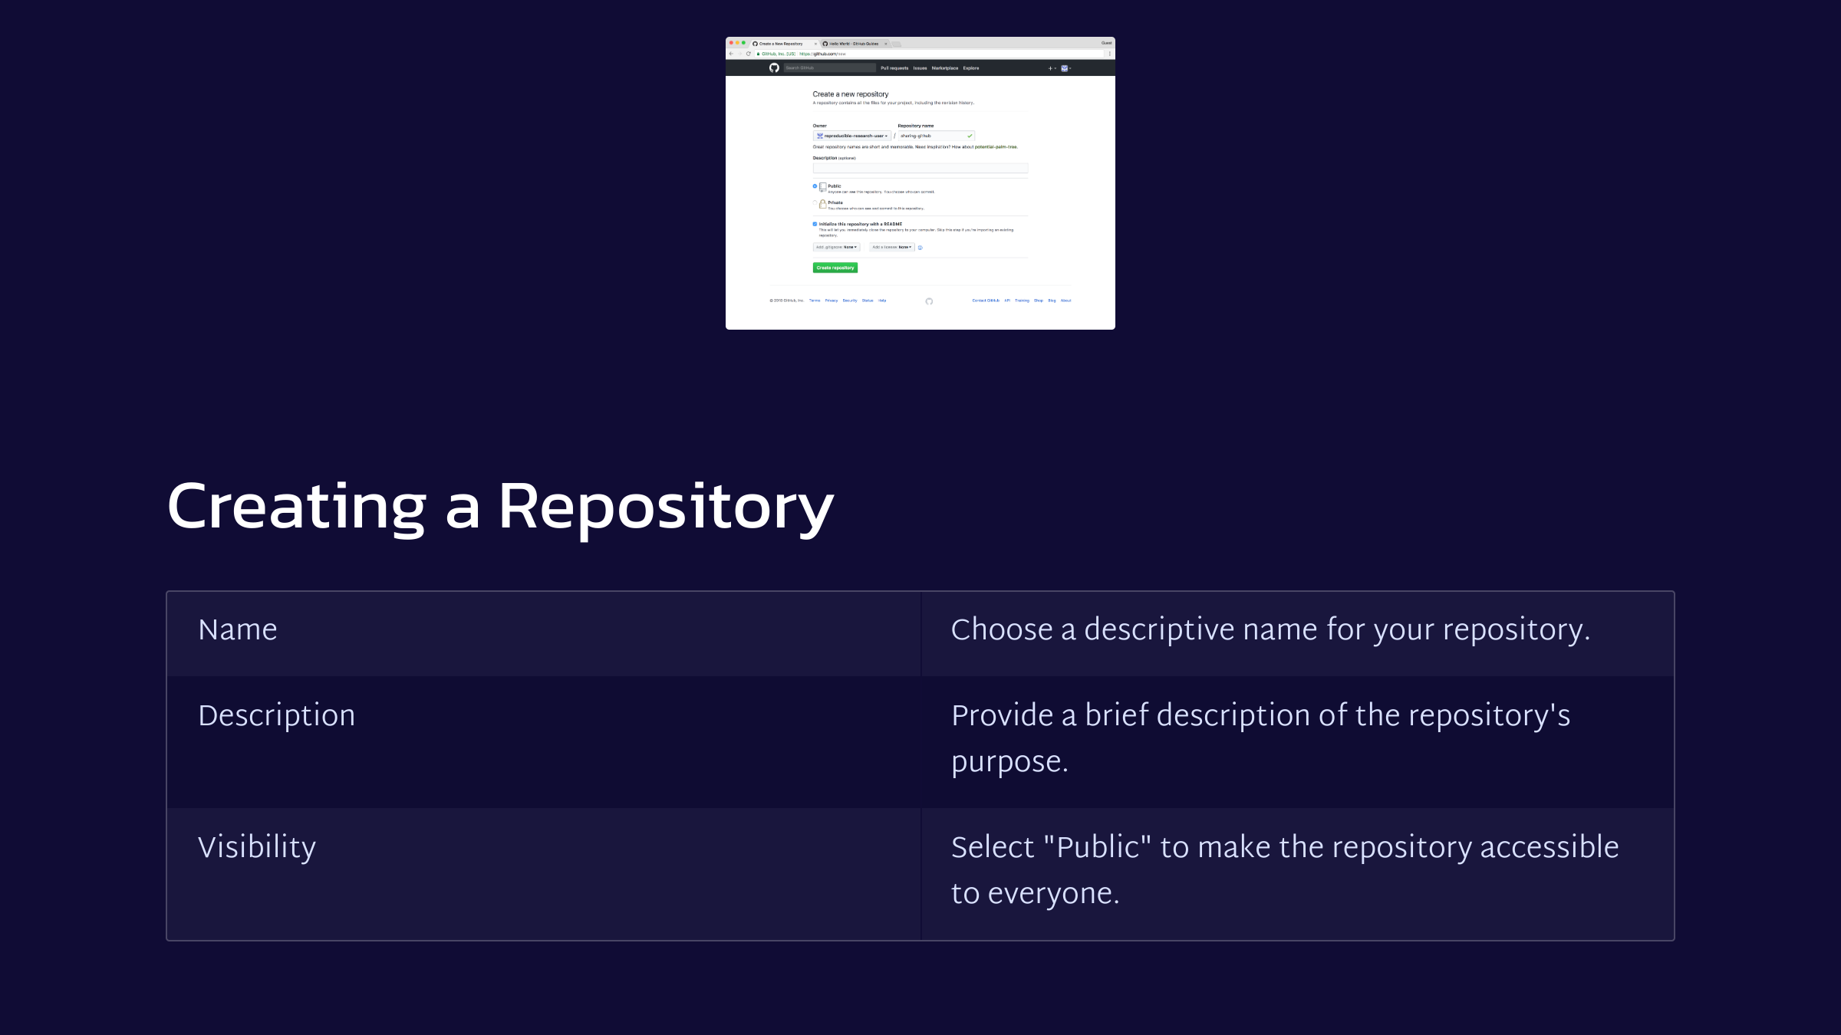
Creating a Repository
Name
Choose a descriptive name for your repository.
Description
Provide a brief description of the repository's purpose.
Visibility
Select "Public" to make the repository accessible to everyone.

Slide 8


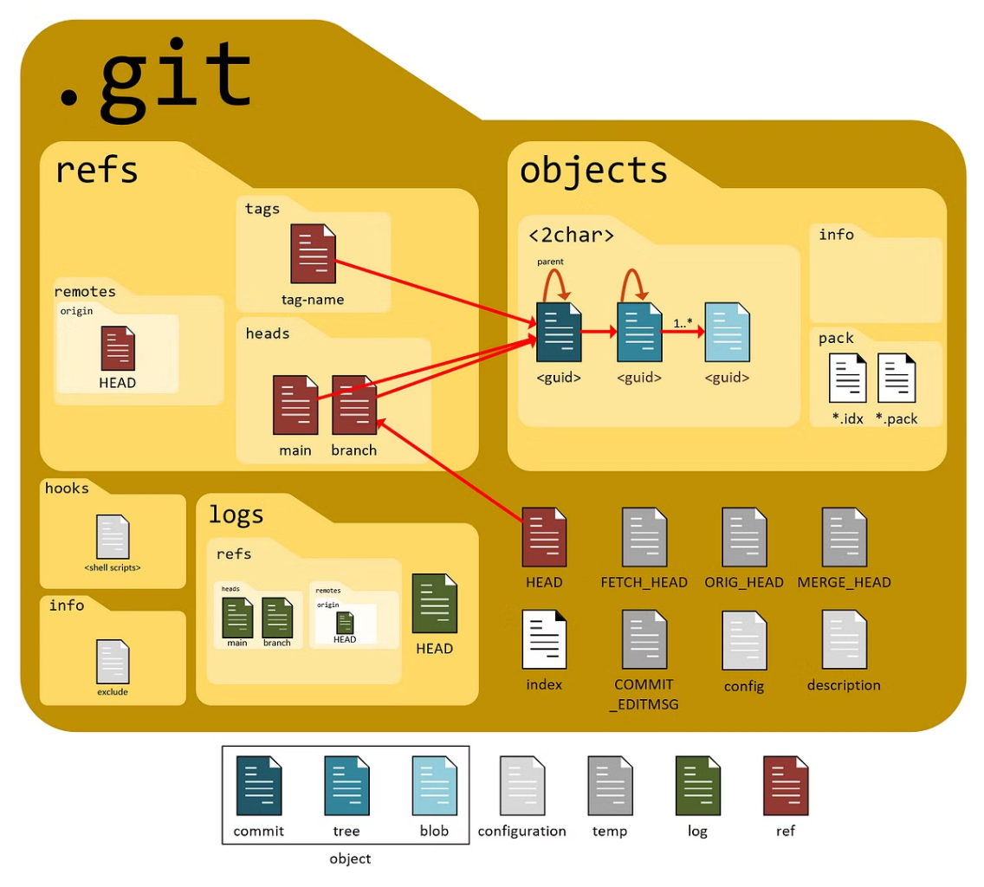



Using the Repository
Organize Files
Create folders and files within the repository to structure your project.
Add Code
Add your code files to the repository and track changes.
Commit Changes
Commit your changes regularly to save progress and create a history.
Push to Remote
Push your changes to the remote repository to share them with others.

